Slide 1
House Pricing
House Price deals with various factors
1- Its is not easy to buy House
2- House price depend on Area
3- Neighbour
4- No of Rooms
5- No of Stories and many more factor comes while buying house

Slide 2
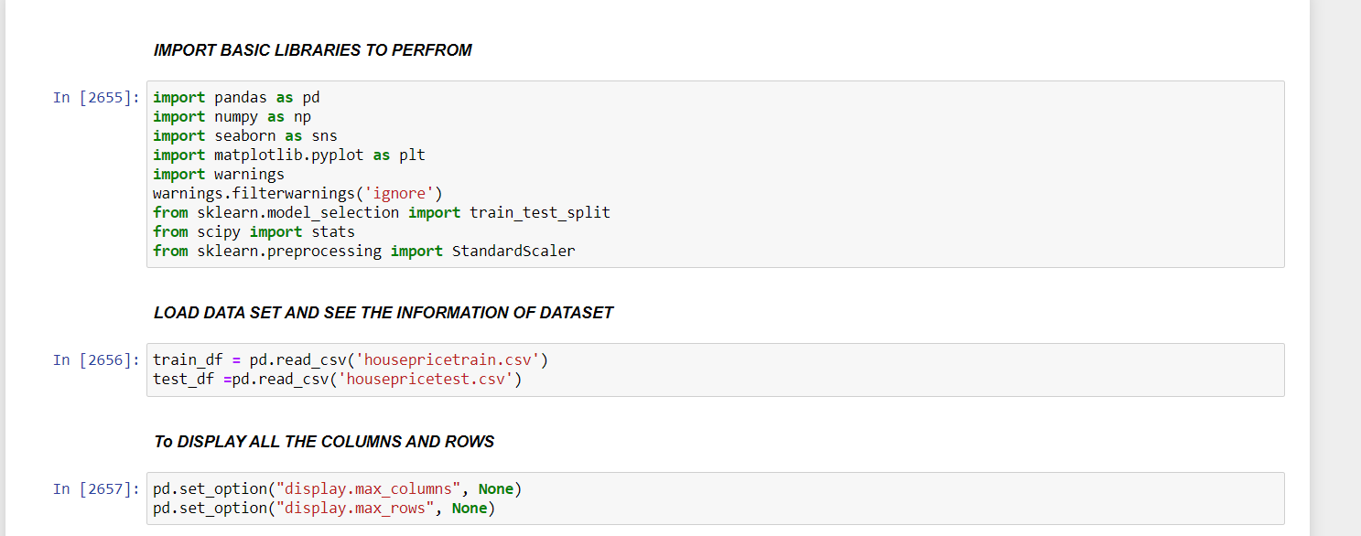
I have Load the Basic Libraries and make two variable for test and train to store dataset. In Train training data stored and in test test data stored. To show all rows and columns I have used pd.set_option(‘diplay.max_columns’,None) -> show all columns and pd.set_option(‘diplay.max_rows’,None) -> show all rows

Slide 3
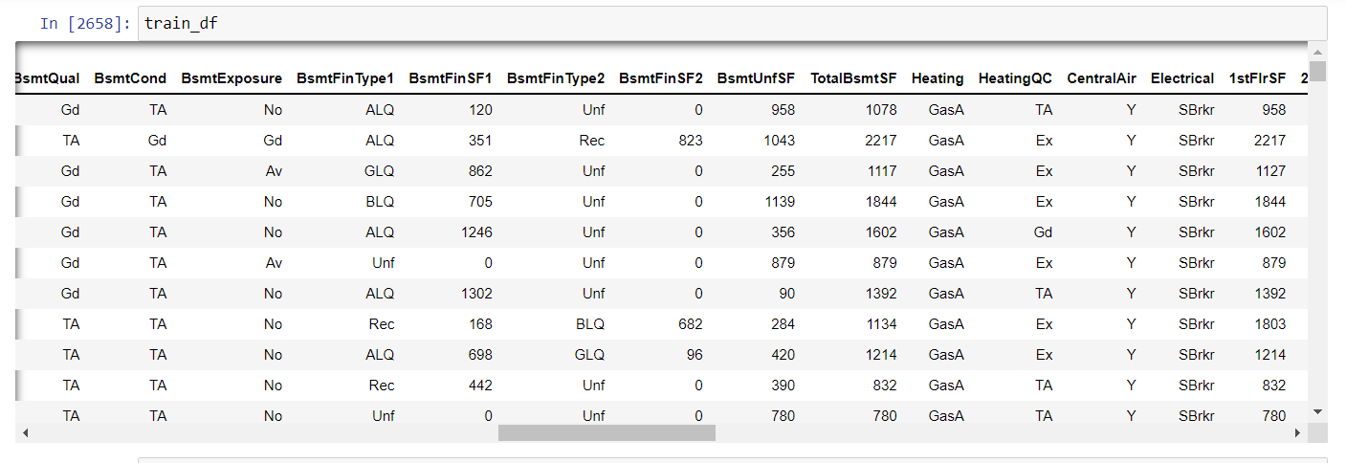
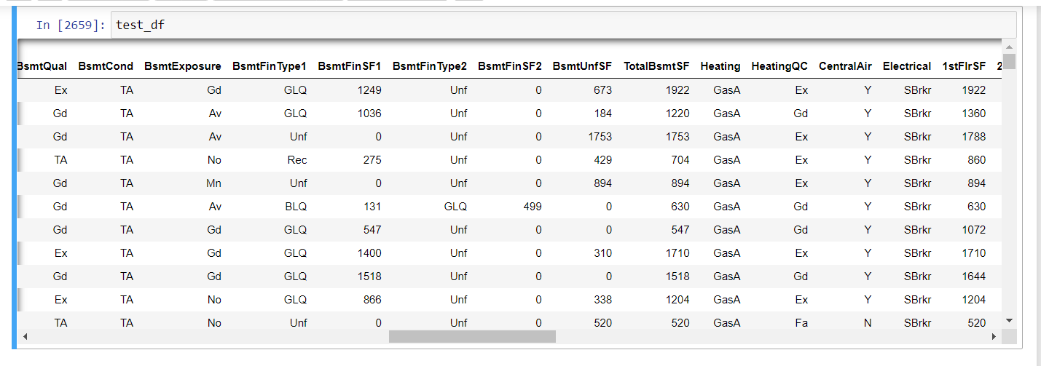
Training and Test data

Slide 4
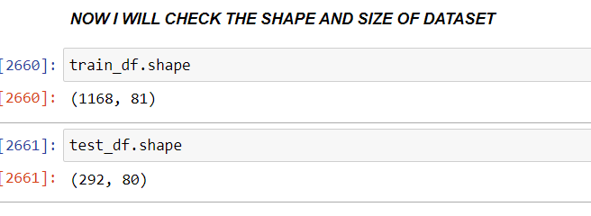
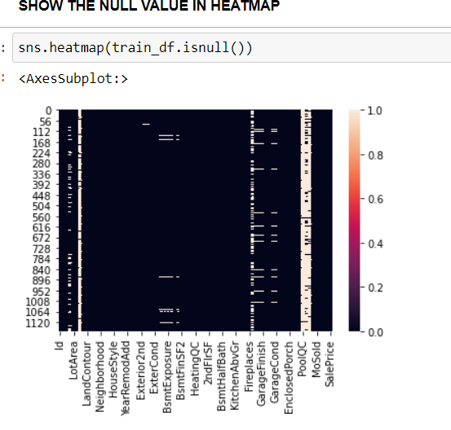
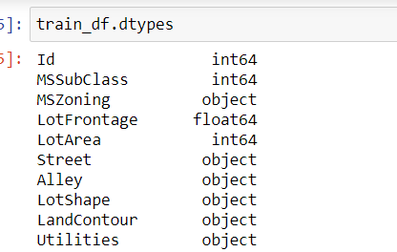
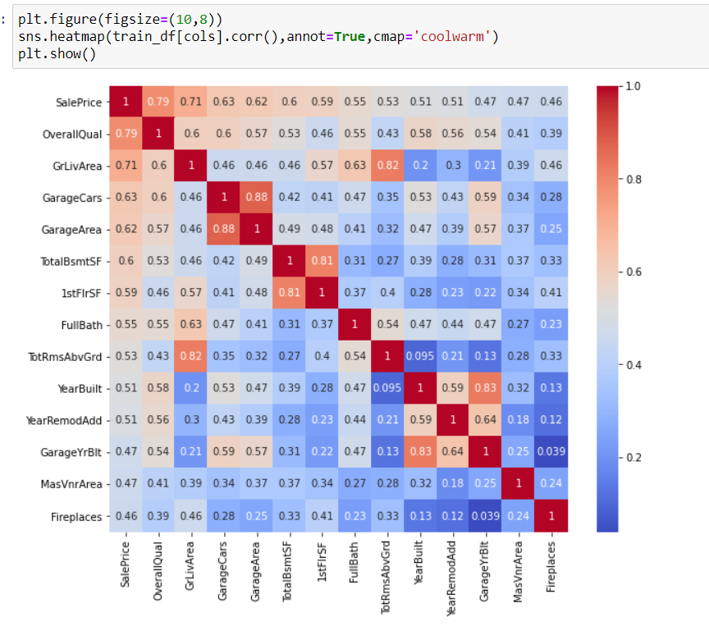
EDA – In EDA I have describe the data set .show its shape ,Data types, Missing value , Statistical information of dataset, Heatmap to show correlation and other visualization techniques like Boxplot to detect outliers ,Bar plot to show the Relation between price with independent columns.

Slide 5
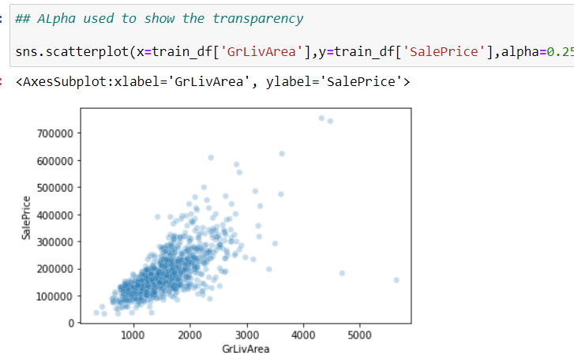
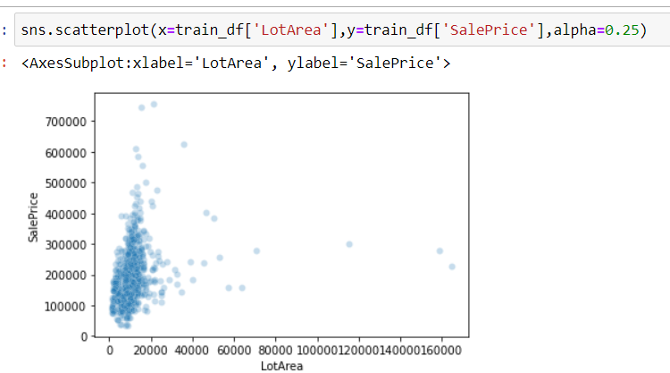
Scatter Plot to show the outliers and bonding between both columns

Slide 6
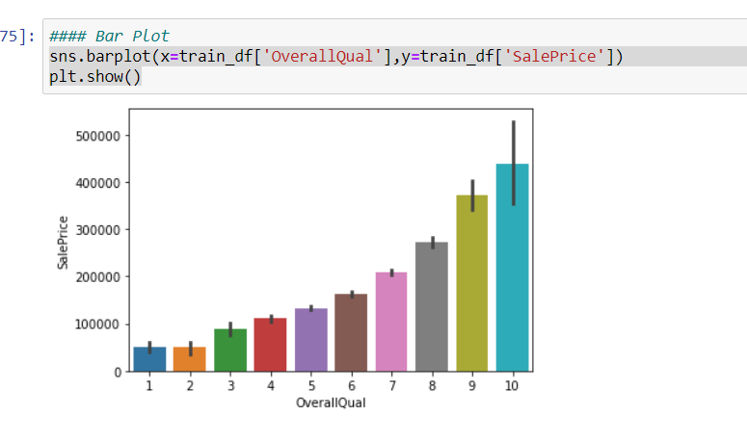
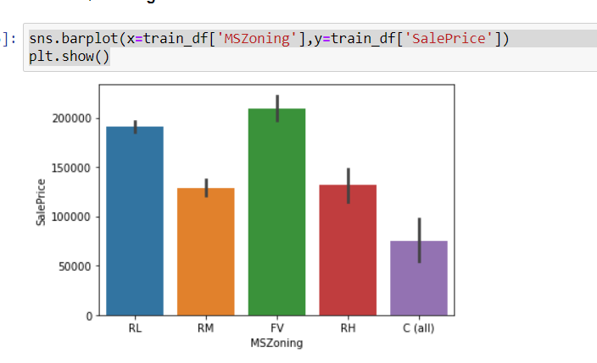
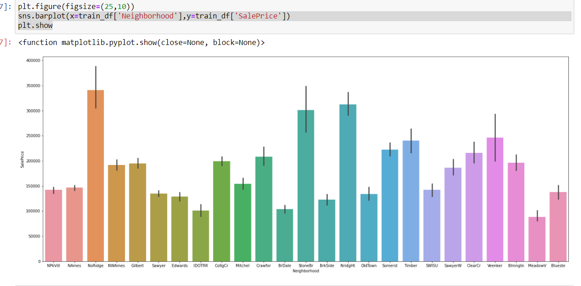
Bar Plot to show the variation in price

Slide 7
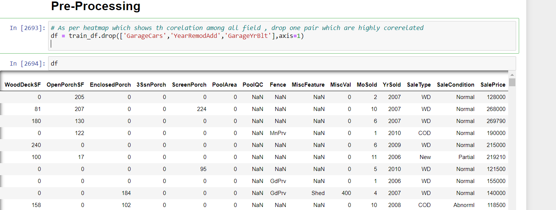
Pre-Processing Techniques used to handle the missing vale,outliers,skewness and many more techniques used.Pre-Processing is most important part of dataset,drop the one pair if higly corelated.

Slide 8
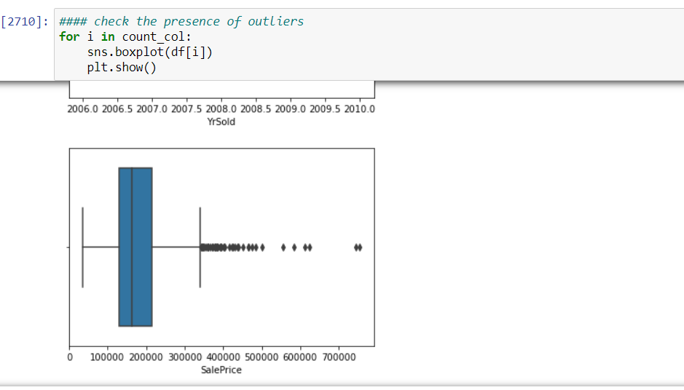
Boxplot to detect the outliers.Use for loop to get all at once and apply filter as per view

Slide 9
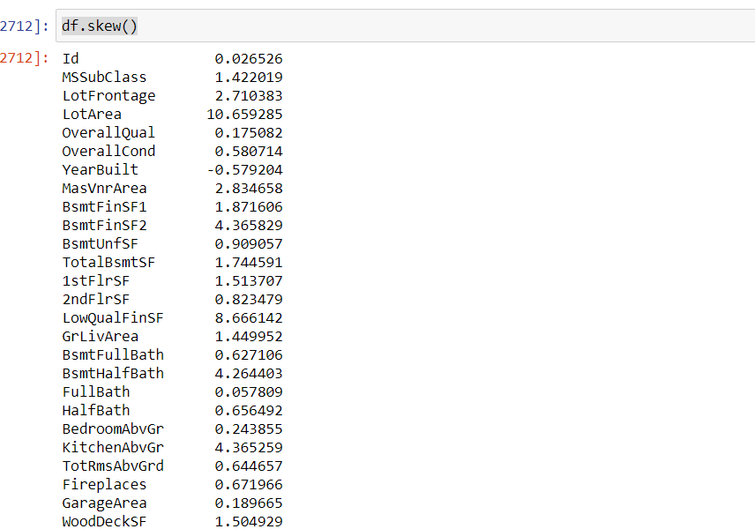
Here I check the Skweness

Slide 10
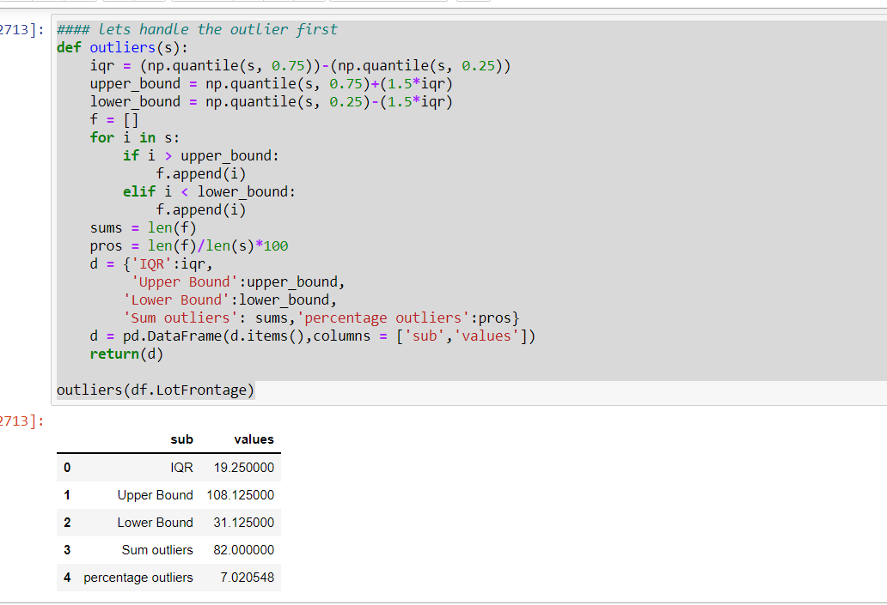
Handling the outliers. Create one function to handle the outliers

Slide 11
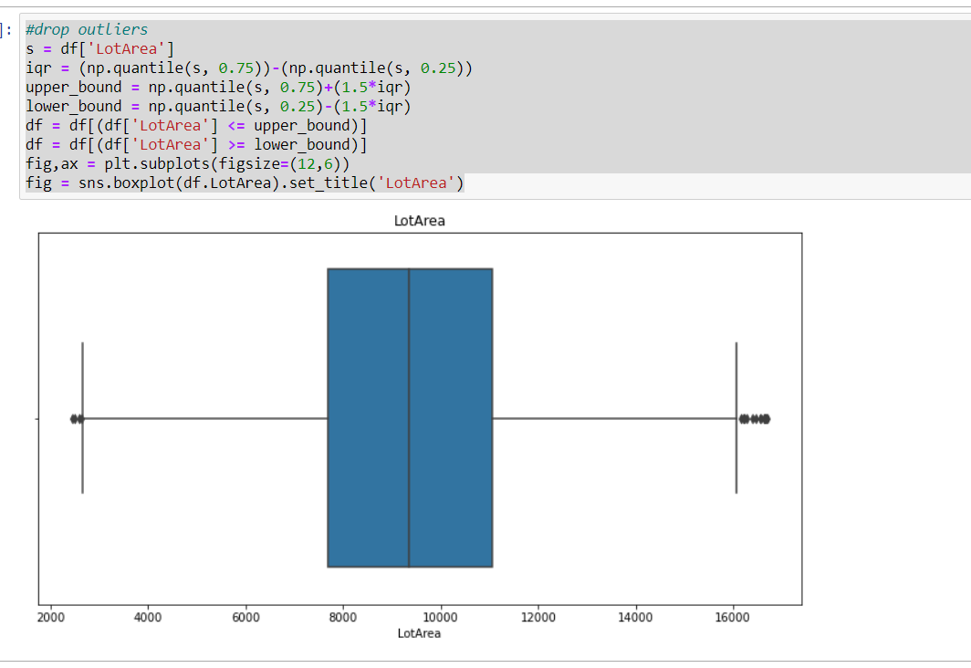
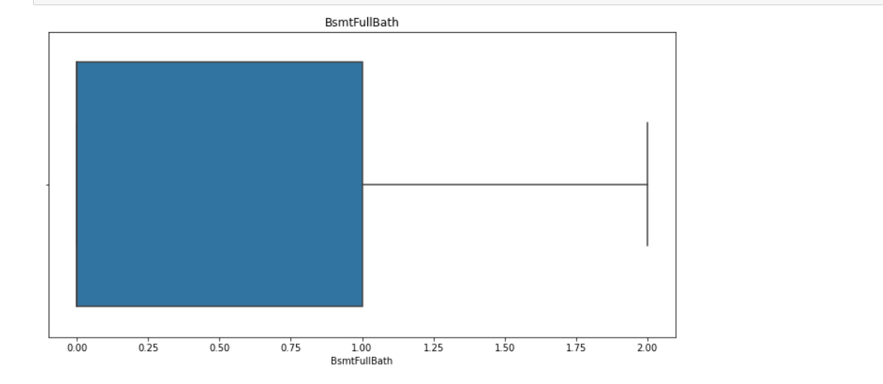
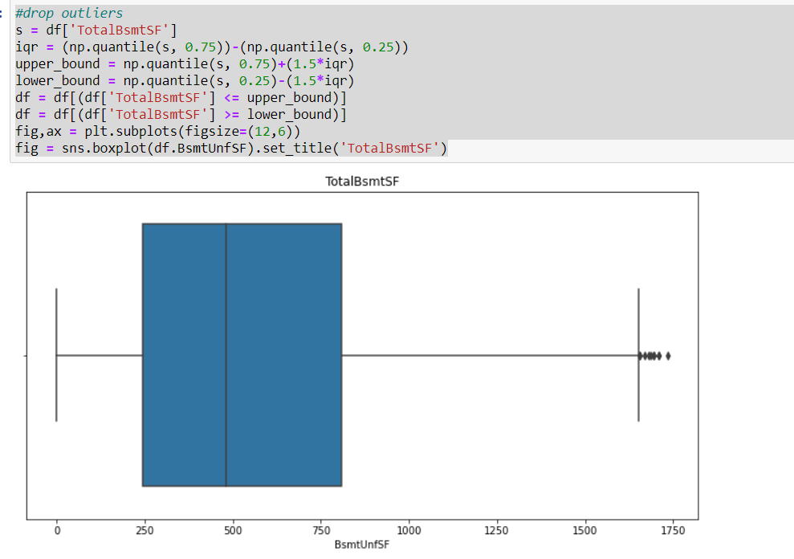
Showing graph after handle the outliers

Slide 12
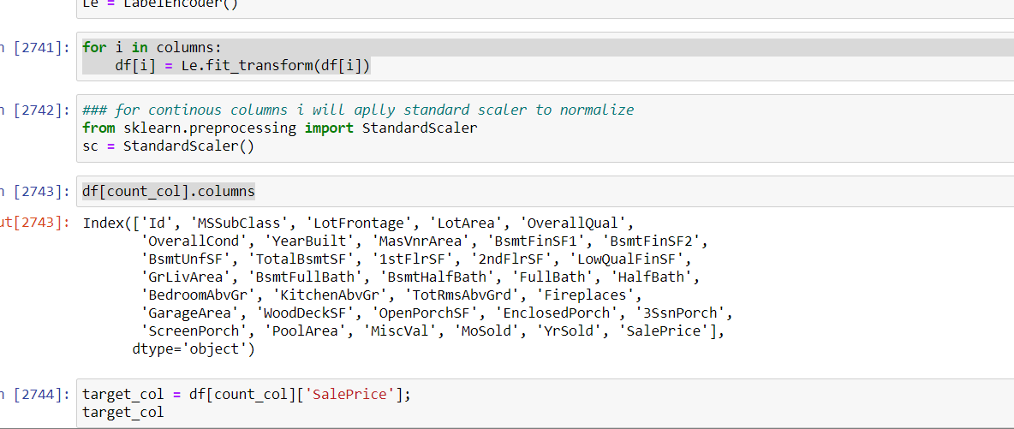
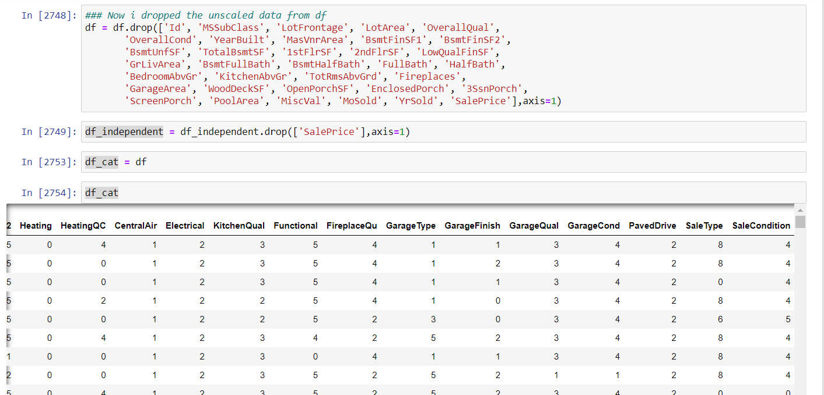
Apply Label Encoder for Categorical Columns and standard scaler for continuous columns

Slide 13
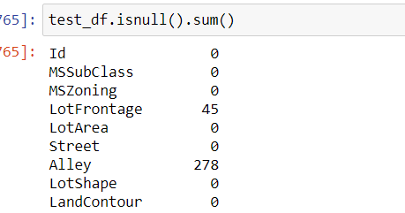
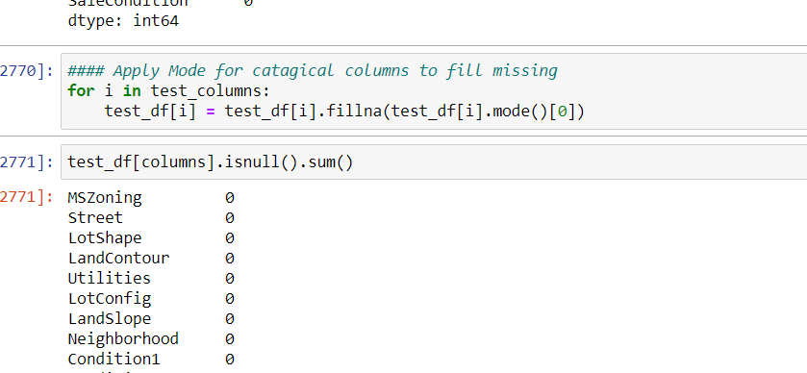
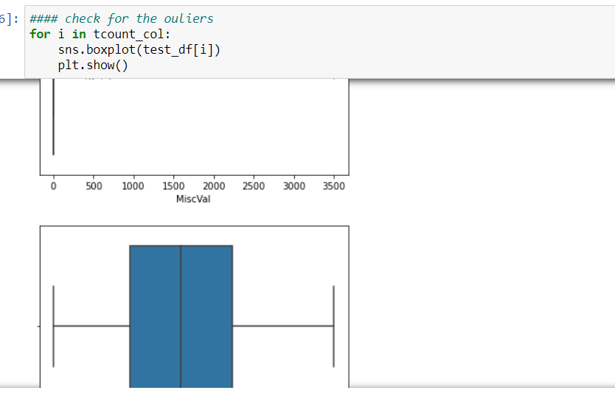
Same Techniques Applied with testing of Data

Slide 14
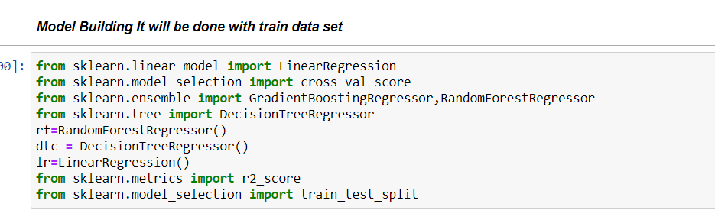
Finally Prepare model with training dataset

Slide 15
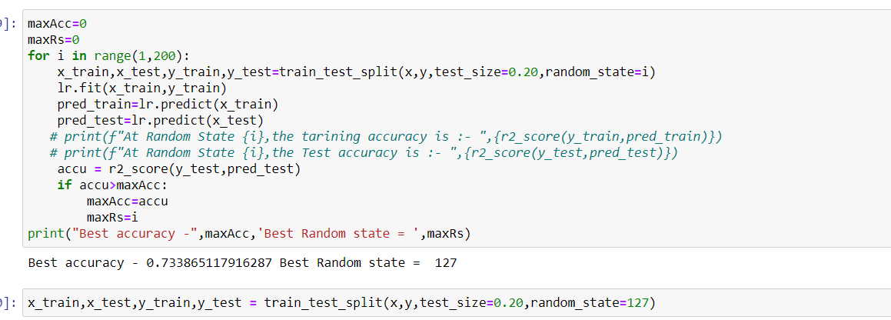
Find the best accuracy and random state. Use Train_test_split for split the data into training and testing

Slide 16
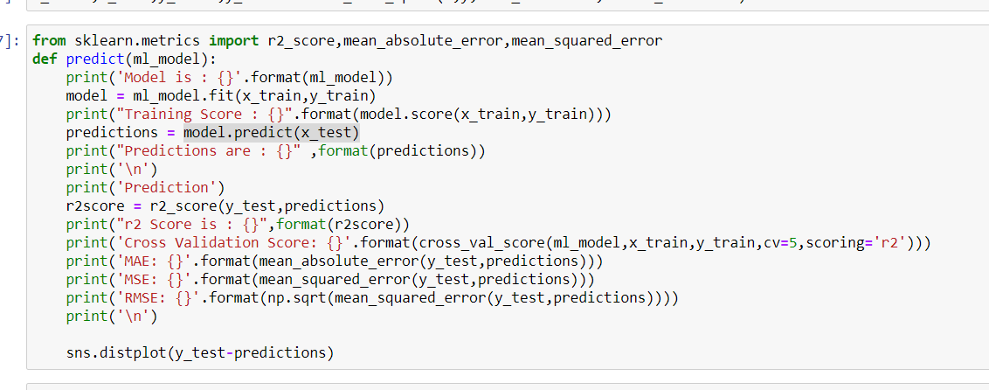
Define Function to Prepare model which shows how model is fit the data and predict the data

Slide 17
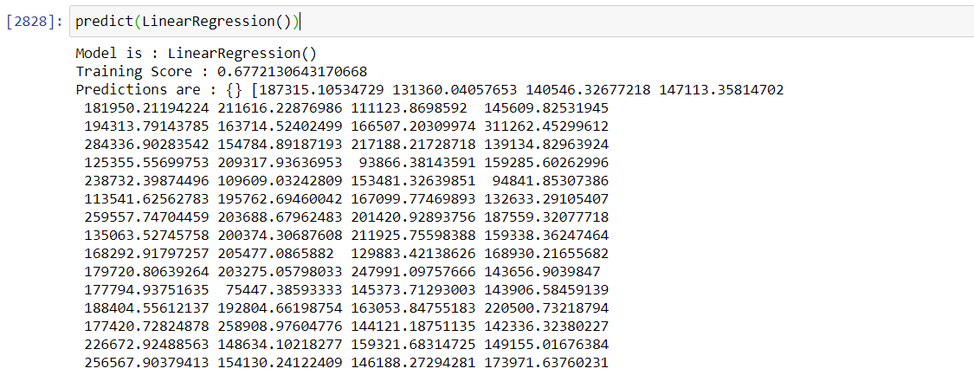
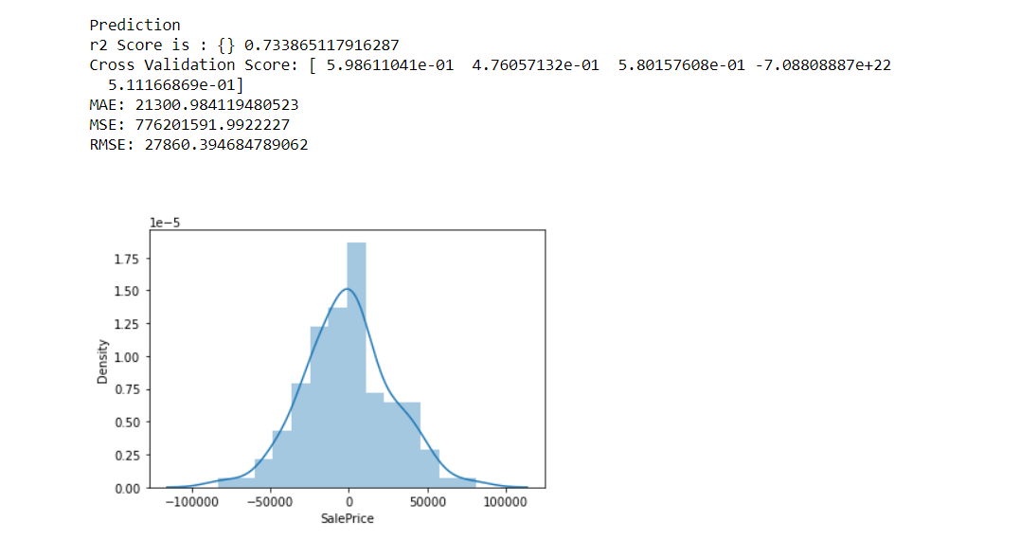
LinearRegression

Slide 18
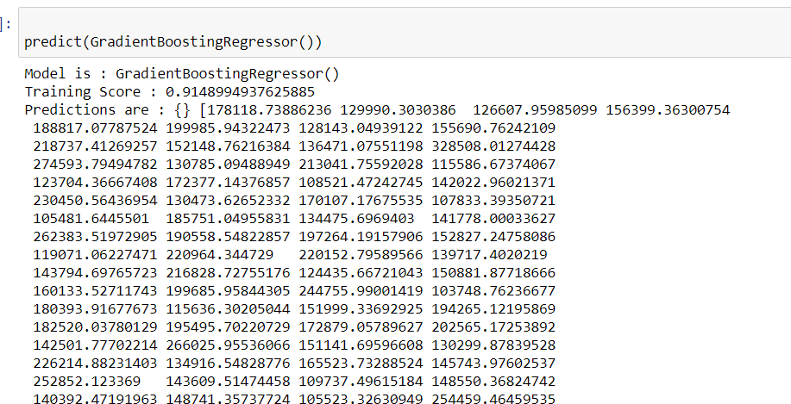
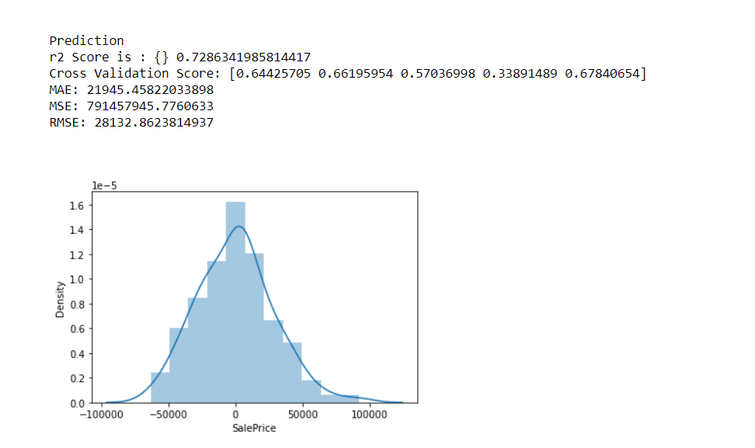
GradientBoosting

Slide 19
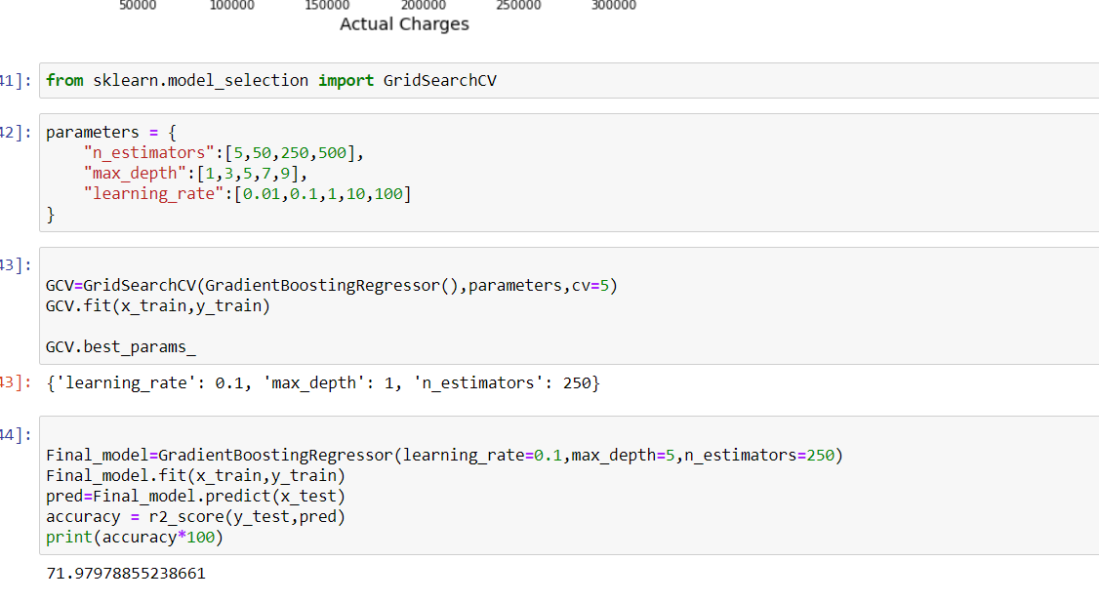
Hyper Parameter Tunning to tune the score

Slide 20
Conclusion
Finally we get the r score for best model and then we save it.
I have used different techniques to get the r score,cross validation score,RMSE,MSE,MAE.
To get better Accuracy use hyper parameter tunning.
Also used test data set to predict with tarining dataset.
There is also a chance of improvement to find more better accuracy .

Slide 21
Thanks You

